Slide 1




Three Techies
HACKTOBERFEST 1.0

Slide 2


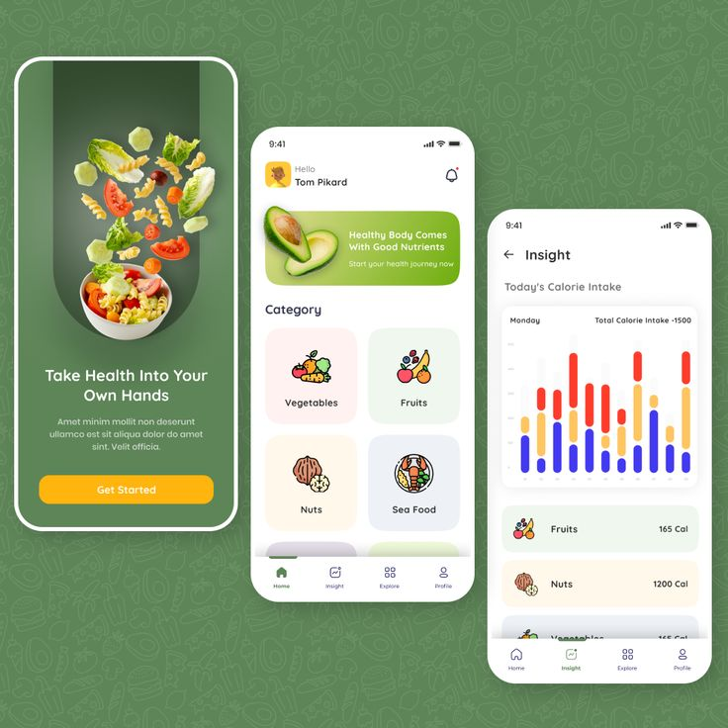

Problem statement
Calorie Tracker
Creating a calorie tracker is important and relevant to a wide target audience, including individuals who are conscious of their health, fitness enthusiasts, people aiming for weight management, and those with specific dietary requirements. Here's why this problem is significant
PIDE STATISTICS OR DATA TO SUPPORT YOUR ARGUMENT.

Slide 3





jhd
Solution
To address this need, we propose the development of a cutting-edge mobile or web application, a "Calorie Tracker." This application will feature a robust calorie tracking system, enabling users to easily monitor their daily calorie intake. It will also have the capability to generate customized diet plans based on individual goals and preferences. In addition, the application will conduct comprehensive nutritional analysis for users, providing valuable insights to help them make informed dietary choices. This integrated solution aims to empower individuals to manage their nutrition effectively and achieve their dietary goals.

Slide 4
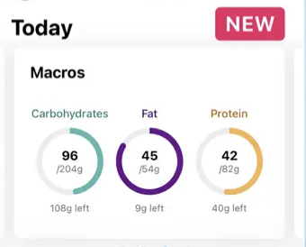
User registration and profile management
Calorie Tracking with Extensive Food Database
Customized Diet Plans
Nutritional Analysis with Visualizations
Barcode Scanner for Quick Input
Physical Activity Tracking
Goal Setting and Tracking
Meal Planning
Reminders and Notifications
Measures
Integration with Wearable Devices and apps
Key Features and Functionality
User registration and profile management
Calorie Tracking with Extensive Food Database
Customized Diet Plans
Nutritional Analysis with Visualizations
Barcode Scanner for Quick Input
Physical Activity Tracking
Goal Setting and Tracking
Meal Planning
Reminders and Notifications
Measures
Integration with Wearable Devices and apps

Slide 5



Social impact
Empowering Individuals
By providing a tool to make informed dietary choices, the app has the potential to positively impact the overall health and well-being of individuals.
Reducing Health Risks
Improved awareness of calorie intake and nutritional content can contribute to reducing health risks associated with poor diet choices.
Inspiring Healthy Habits
By helping users track progress towards health and fitness goals, the app encourages the adoption of sustainable healthy habits.

Slide 6




Technologies Used
OUR TEAM UTILIZED A VARIETY OF TECHNOLOGIES INCLUDING PROGRAMMING LANGUAGES LIKE DART AND PYTHON, AS WELL AS TOOLS LIKE GITHUB AND Flutter, API integration ,Machine Learning and Data Analysis.

Slide 7

The Team
Adnan
Pranav
Sharfa

Slide 8


Thank You
HACKTOBER FEST

